Slide 1
Coding AI
By: AI Club Leadership Team

Slide 2
Many different fields of AI
You can’t just say I want to program in AI because there are about 20 different field of AI and 20 more branches of each field

Slide 3
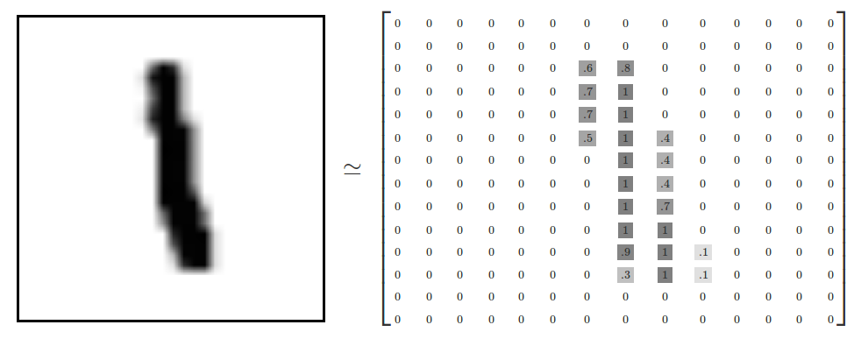
Why do we use AI
AI AUTOMATICLLY generates a algorithm which will solve a solution
Detecting a face, the different densities of color will vary each number/ pixel in the array
We just have to give in the data and it will automatically make the algorthim

Slide 4
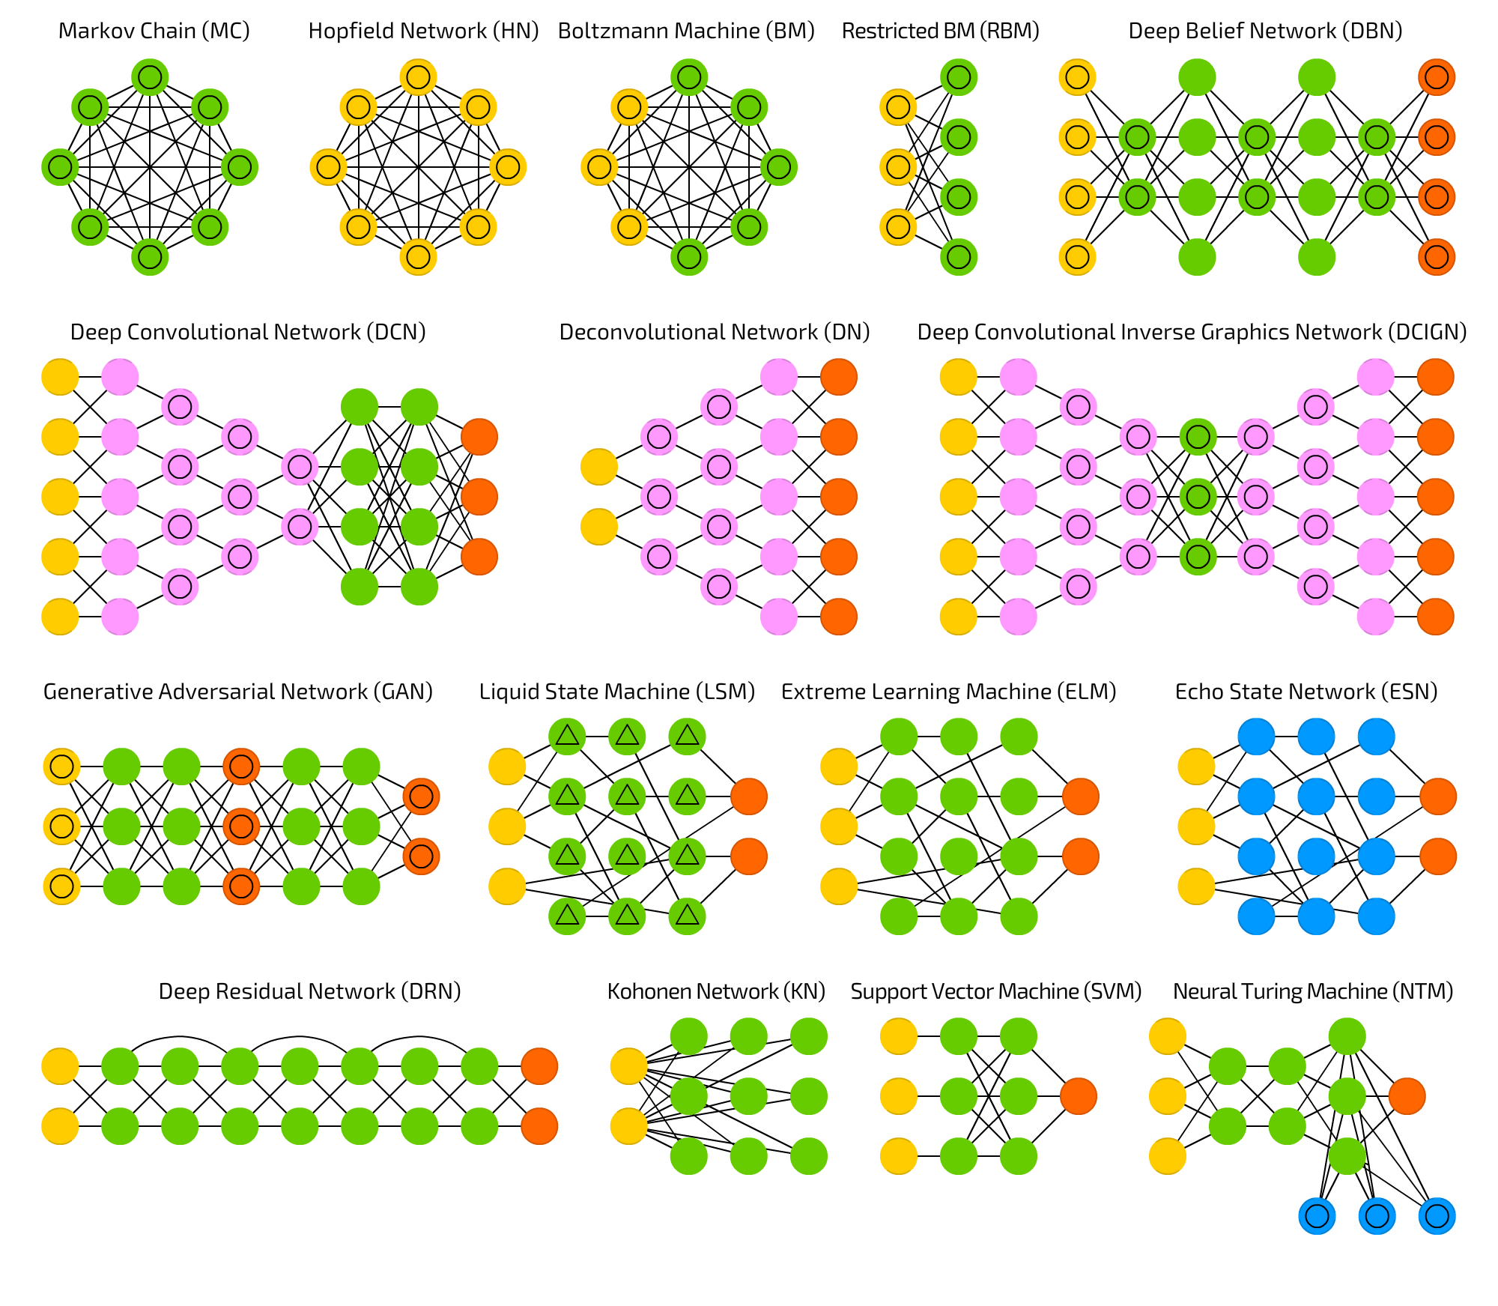
Different types of ways to generate the algorithm Neural Networks
Each dot is a neuron
Each red dot is a final output
Each green, pink and blue dot is a weight variant
The mix of connecting each neuron, varies the output result and different types are used for different use cases.

Slide 5
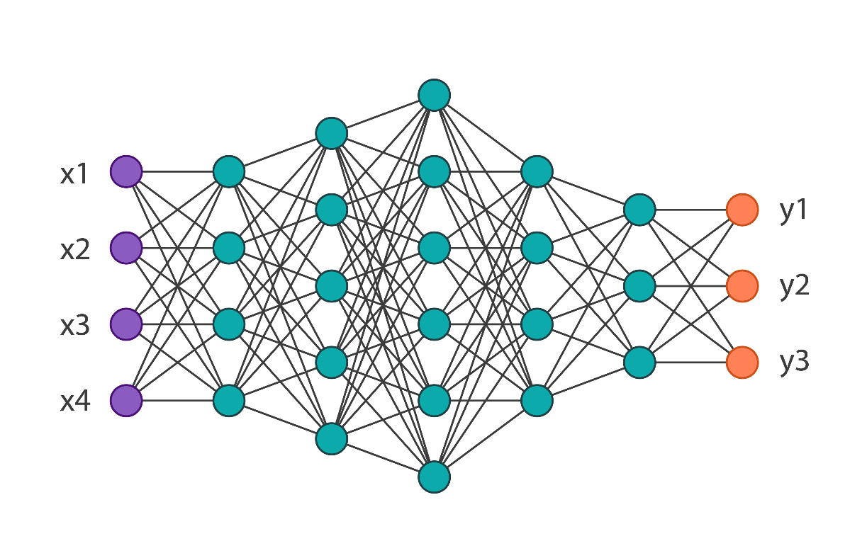
Convolutional Neural Networks – What we use
One of the more advance's networks, and could be used in many different places

Slide 6
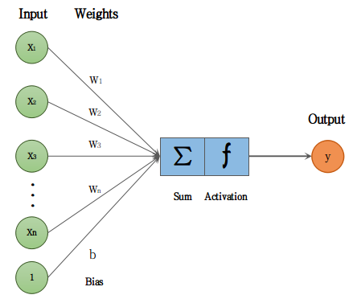

Weights in CNN
To develop a better algorithm we need more pictures.
With more pictures going through the process, each dot has a specific number which is changing slightly. By 0.1
When all pictures have ran through the network then the CNN takes in all the weight values and generates an algorithm.
[$W_{1}W_{2}$ $W_{3}$ $W_{4}$] → changing each time a picture goes through the model
Final output

Slide 7
How we use it
We can generate a full CNN, but that requires extreme practice in coding and needs a lot high level knowledge of coding
If we make out own then it would work, but when trying to actually implement it/test it the probability will never be high enough. → Project for later date
Transfer learning
Branch of an other’s model and make it optimize it for us
We use their branch of neural networks, but we vary the weights to make it useful for us

Slide 8
Some basic Libraries that we use
Pandas
Dfply
Creating tables and data analysis
NumPy
Array management for pictures
Os (operating system)
File managment
Mathplotlib.pyplot
Generating plots and graphs, and overlaying them over pictures

Slide 9
OpenCV (I)
Open Computer Vision
One of the biggest fields of AI
Many different uses in the real world
The process of capturing data from a camera
Camera
Any sort of camera
Webcam
Already installed camera on your computer

Slide 10
OpenCV(II) – Object Detection
Pretty much just using a webcam and detecting/recognizing/tracking what is in the frame
There are important libraries that you need to use
Main thing we used
Object Detection; Face Recognition; Object Tracking; Line Detection
Video
Pretty much splits the video into frames and then process each frame as a photo
Photo
Now there are different ways for the computer to learn what the object is so – different ways to learn
CNN → Easiest
ETC

Slide 11
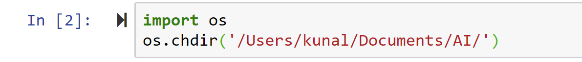
Using the OS library (Documentation in a slide)
Directory
Changes the working file path that it is running
Has no effect until you save something, or run something
Saving Something
When saving, you can either, save to the running directory or to a specific directory
Must use os.chdir to save multiple pictures.
Running/Importing a file
When running your file, you must change the directory to the folder that holds the model file

Slide 12
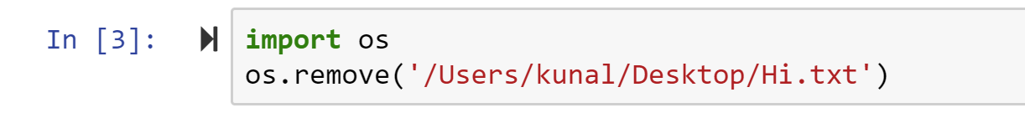
Using the OS library (Documentation in a slide)
Removing a specific file
**IT COMPLETELY ERASES THE FILE**
**NO RECOVERY FOR THIS**

Slide 13
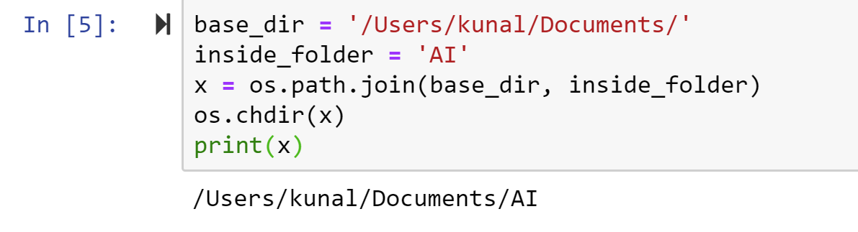
Using the OS library (Documentation in a slide)
This combines two directories (joins)
Uses this when you are using this in a for loop and the working directory is changing each time you go through the loop
Concates the two strings
If there is a “/” at the end of the first string then it will not add a “/” between both string
Otherwise it will

Slide 14
Capturing a video Full Process → With task at the end

Slide 15
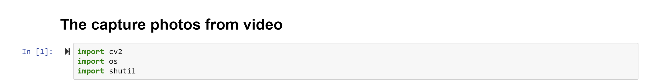
Import necessary files

Slide 16
Directory Change
https://docs.python.org/3/library/os.html
Search up os documentation python
#prints out the running directory
#os.listdir()
#who did you login from
#os.getlogin()

Slide 17
INPUT()
From python the input() function allows users to type in anything

Slide 18
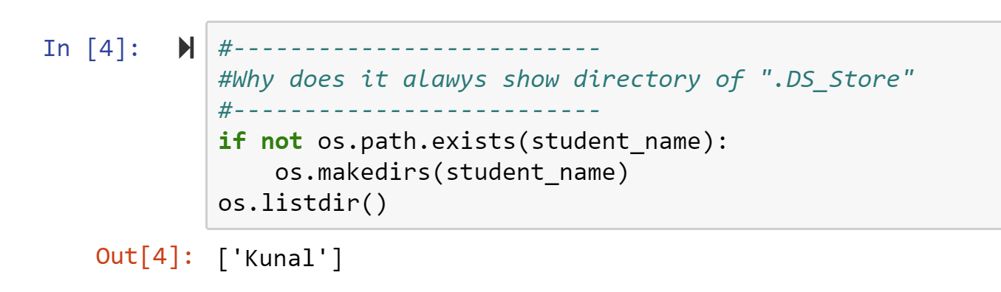
Directory and variables
Variable management

Slide 19
Directory and variables

Slide 20
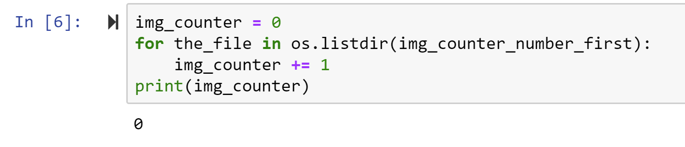
How many pics previously there

Slide 21
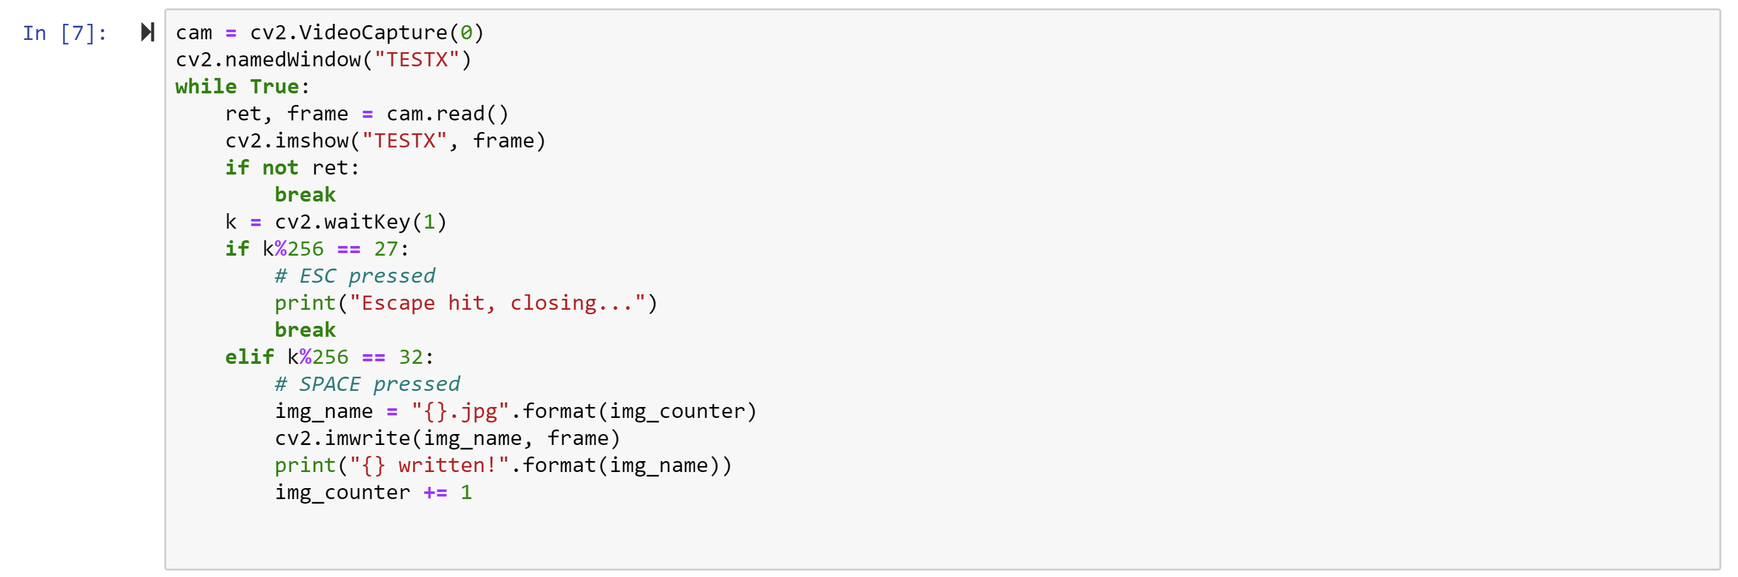
RUN CODE
Method from the cv2 library calling the webcam from computer and saving it to var cam
Method that opens and names a py window
While loop
Read is a method from the cv2 library that takes in data from the Video Capture method and gives out 2 pieces of data and saving it to 2 variables
Ret is a Boolean that states if the capture is running
Frame is the array/frame pic from webcam
Imshow is a method from the cv2 library that displays a image/video on the screen
It uses the previously named window in line 2
And displays the frame taking in line 4
If else statement that stops if no running video
Breaks from loop
Wait key is a method from cv2 library that takes in data from the keypad and saves it to the var “k” → Int data type (each key on keypad is linked to a specific number)

Slide 22
RUN CODE
**Still in the while loop**
Checks if the remainder of k divided by 256 (the number of keys) is equal to 27
Can just do directly if equal to 27 because it will result in a automatic click of 27 because of how the method is built
Prints the line
Breaks out of the loop
Java (else if) → checks if the space bar was clicked in same format
Sets “img_name” to the string of “[[name]].jpg”
[[name]] is img counter
Img_counter was a var set to 0 previously
Imwrite is a method from the cv2 library that saves a picture
Print the line “1.jpg written!”
Add one to the var “img_counter”

Slide 23
QUIT WEBCAM WHEN DONE

Slide 24
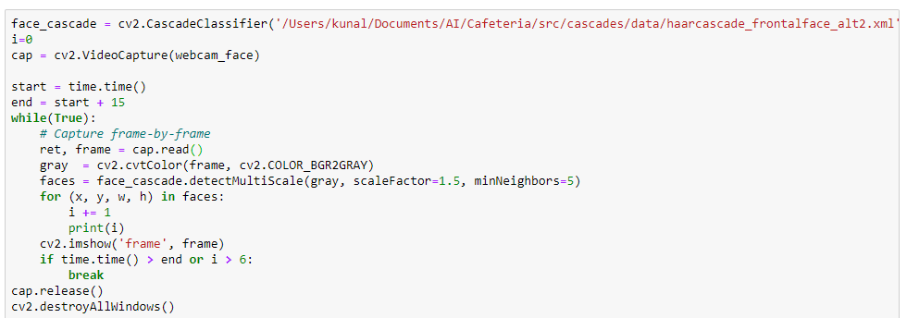
What does this code do
Pretend all libraries are imported
Hint: the first file is the model file; available to the public with no change; already downloaded to my computer
Hint: Inspect each line of code

Slide 25
Things to build on
Saving a video
Processing a video so it will save it
Take each frame from a video and save them
Detect a face from the previous saved picture
Any idea what you want to do

Slide 26
Use google
Most of coding is searching
Learn how to make smart search queries
Just copy the error into google
Look for inspiration in Google

Slide 27
Our Projects
Robot
Robot in shipment and we will be starting the training as soon as we get the robot
ID Scanner
We can start right now
All you need access to a web camera which you have on your computer and we have it
Cafeteria
The code is already there and shared with you
Will start in the upcoming weeks
Drone (New Idea)
Similar to spark drone and it will be controlled by hand
First hack into the drones wifi and then get access to the web camera
Detect hand/face and control the speed of different fans based on that

Slide 28
NLP → Scanner ID Project
Simple start

Slide 30
First task
Be able to detect all the text in the frame
Convert each frame to a

Slide 31
Insta @aiclub.ahs
Join insta for important updates

